Slide 1

I Forgot the Question but Wine is the Answer
Summer Gernon, Pati Virgilio, Ashley Desai, and Darcey Altschwager
Notes:
Darcey

Slide 2
Are you over 21?
Yep! Nope!
Notes:
Darcey

Slide 3

Purpose of study
Questions:
What makes a good wine?
Does a particular type of wine have a higher average score?
Are more expensive wines rated higher?
Can we recommend similar wines based on their description?
Notes:
Darcey

Slide 4
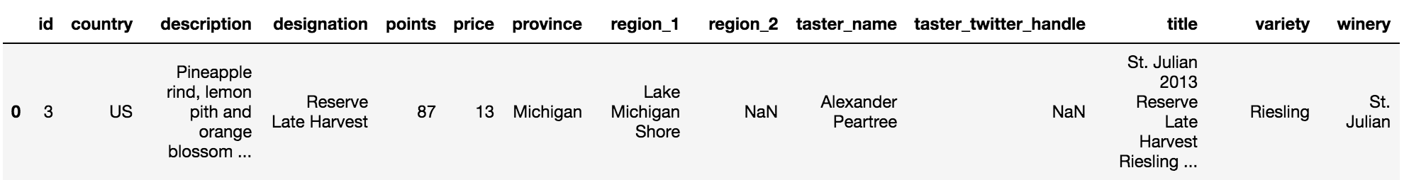
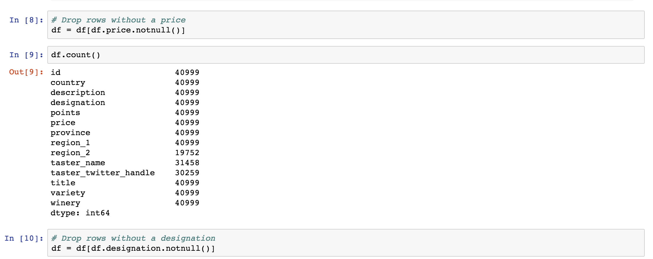
Data
Source: Kaggle.com
Scraped from Wine Reviews on Wine Enthusiast
Cleaned using Pandas
Data included
Country
Description
Designation
Points
Price
Taster Name
Title
Variety
Winery
Notes:
Summer

Slide 5
Notes:
Darcey

Slide 6
Notes:
Ashley present and slack the link to the class

Slide 7

Machine Learning
Recommender System
Pairwise similarity scores for wine description
Construct matrix using Term Frequency-Inverse Document Frequency (TF-IDF)
Scikit-learn
Compute similarity score using cosine similarity
Notes:
Summer

Slide 8
Machine Learning
Increase the quality of recommendations
The model should capture more information in order to give better recommendations
Added taster's name, the grape variety and grape's province
Content Based Recommender System Refinement
Notes:
Pati present and then run notebook

Slide 9
Challenges
Finding appropriate data for Machine Learning
Understanding which type of recommender system would be appropriate to use with our dataset
Saving the model/passing it into flask to render a webpage
Notes:
Darcey

Slide 10

Future areas to explore
Improve the complexity of the system
Introduce popularity
Weight user preferences
Explore models that require user data, such as user-based filtering, collaborative filtering engines
Deploy system on a webpage/or interactive App
Notes:
Ashley

Slide 11
Special Thanks
Brady
Neil
All of our peers who assisted us at any given point in time
Caffeine
Cheap, but good, wine
Notes:
Summer

